Slide 1
Presentation draft

Slide 2
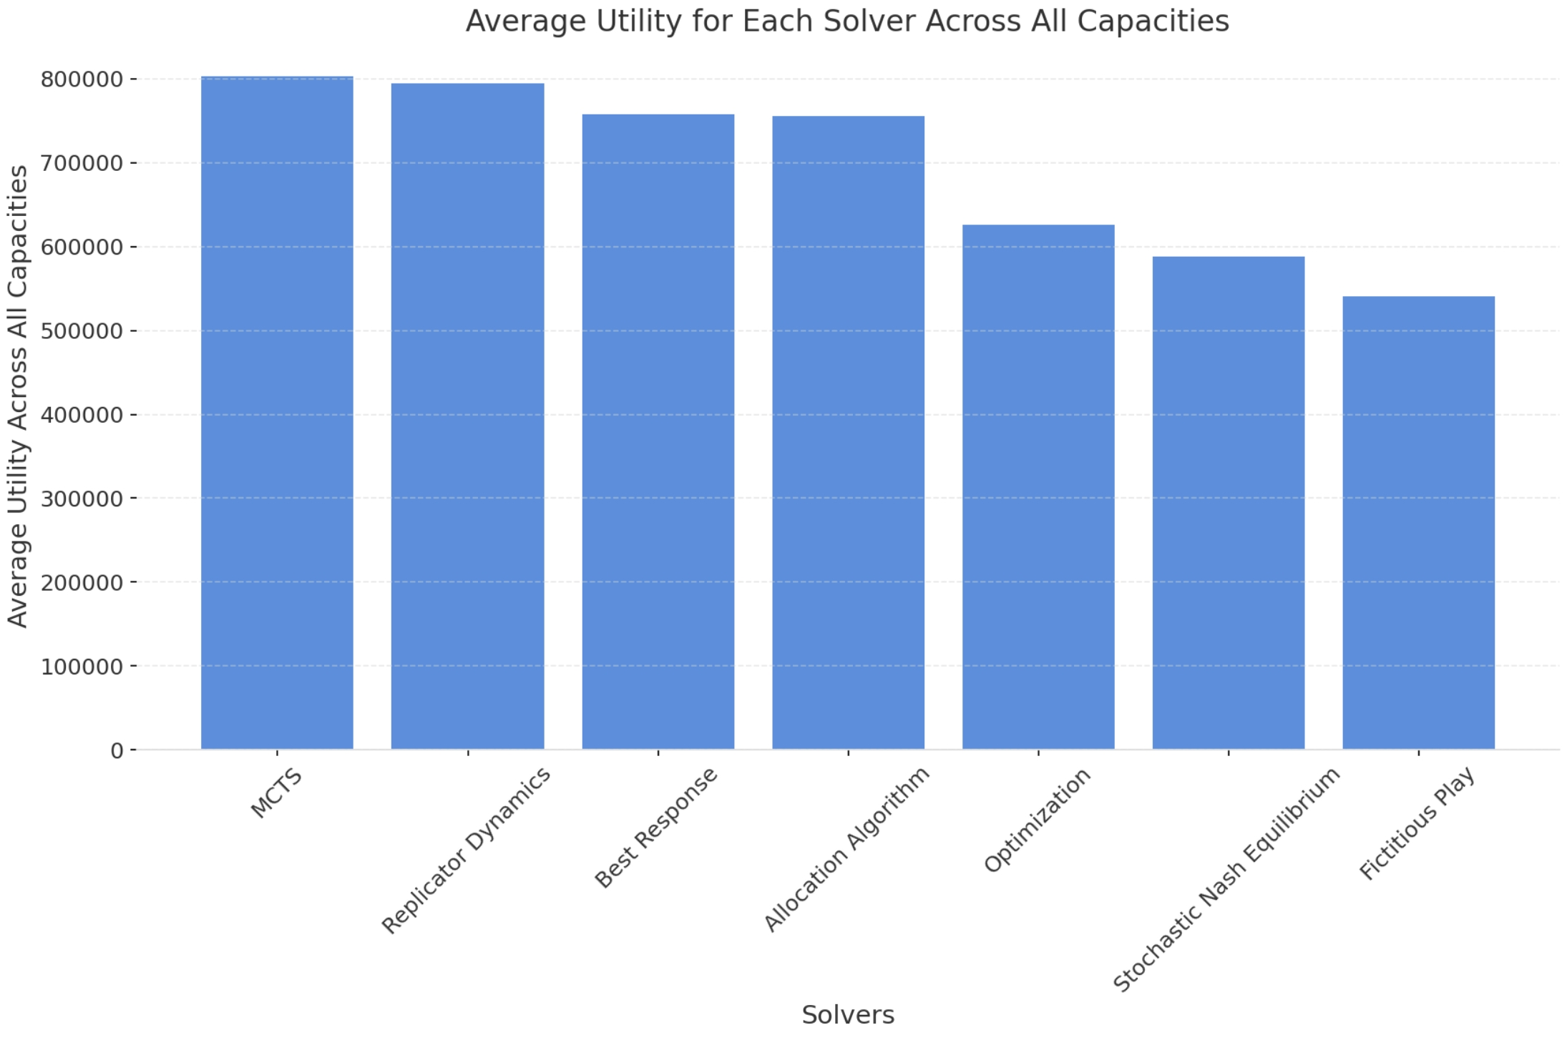

Slide 3
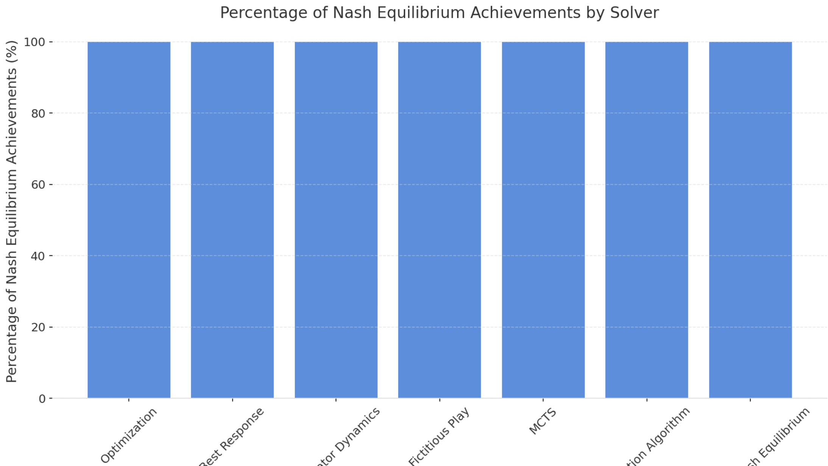

Slide 4
Distribution | AIC
Optimization | Beta
Best Response | Beta
Replicator Dynamics | Beta
Fictitious Play | Beta
MCTS | Beta
Allocation Algorithm | Beta
Stochastic Nash Equilibrium | Beta

Slide 5
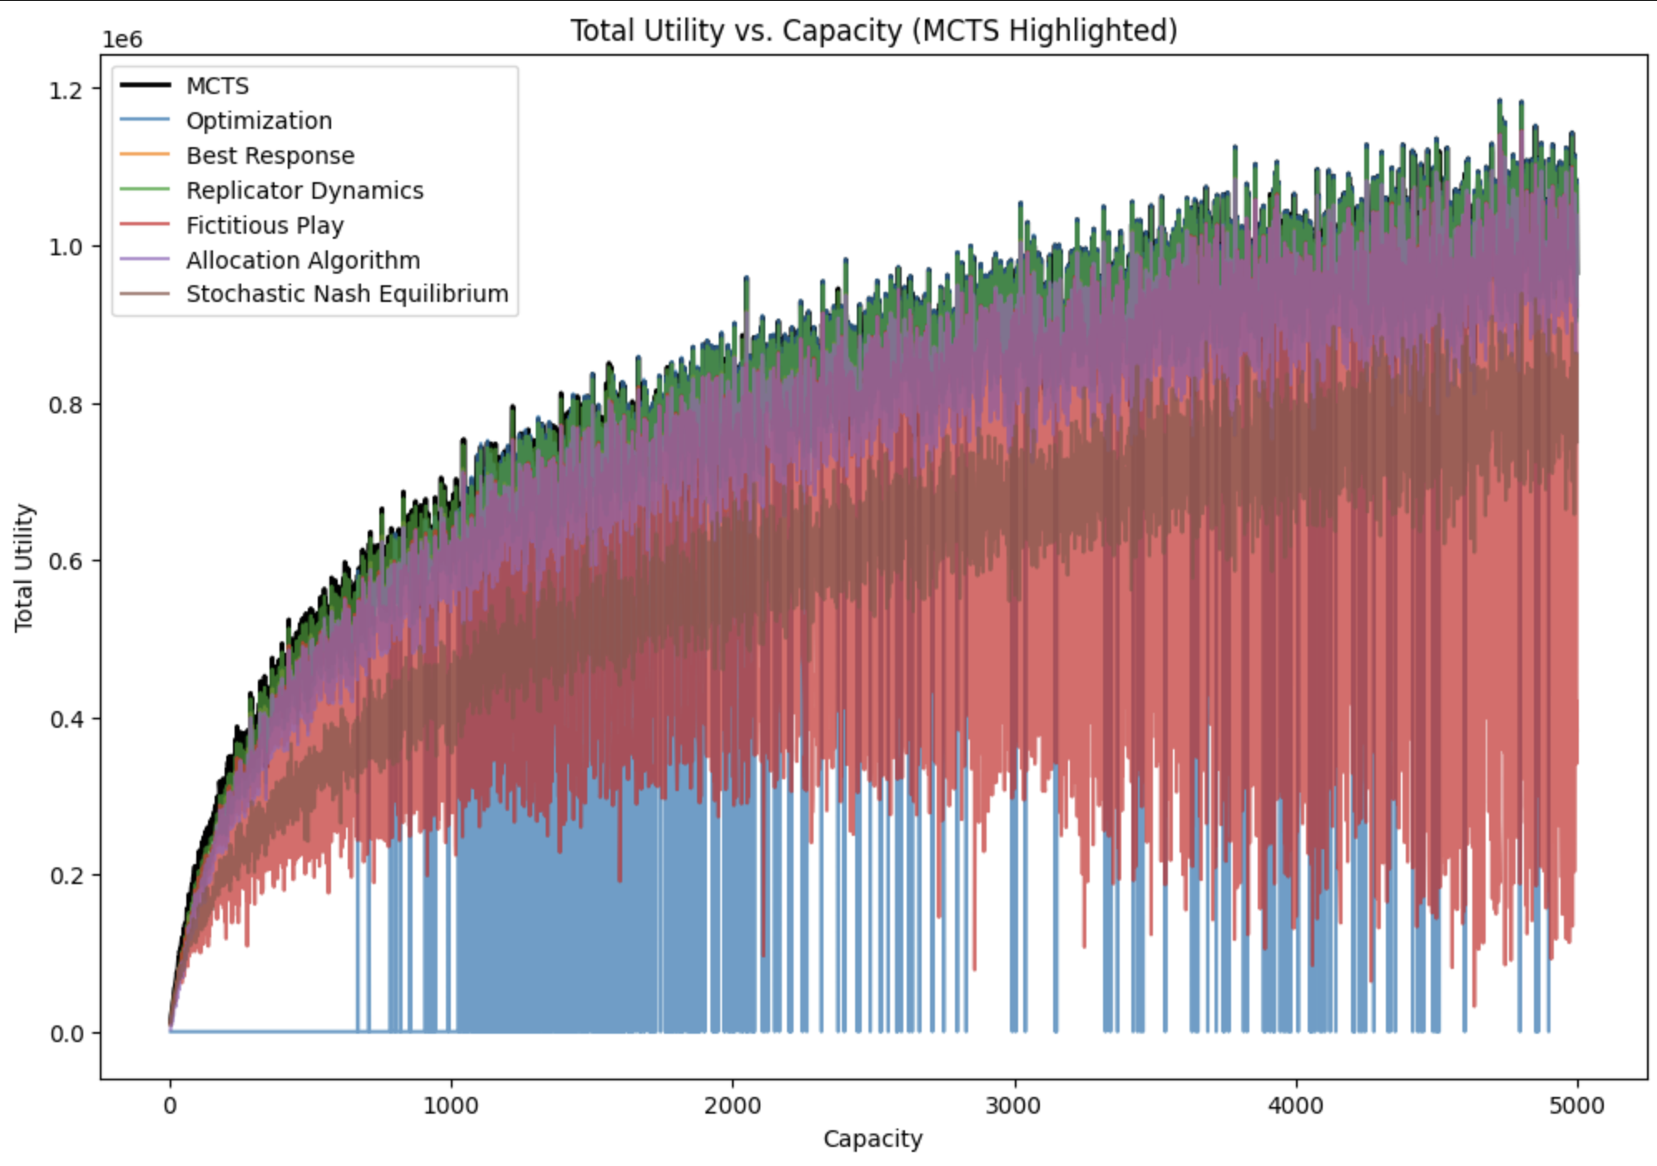

Slide 6
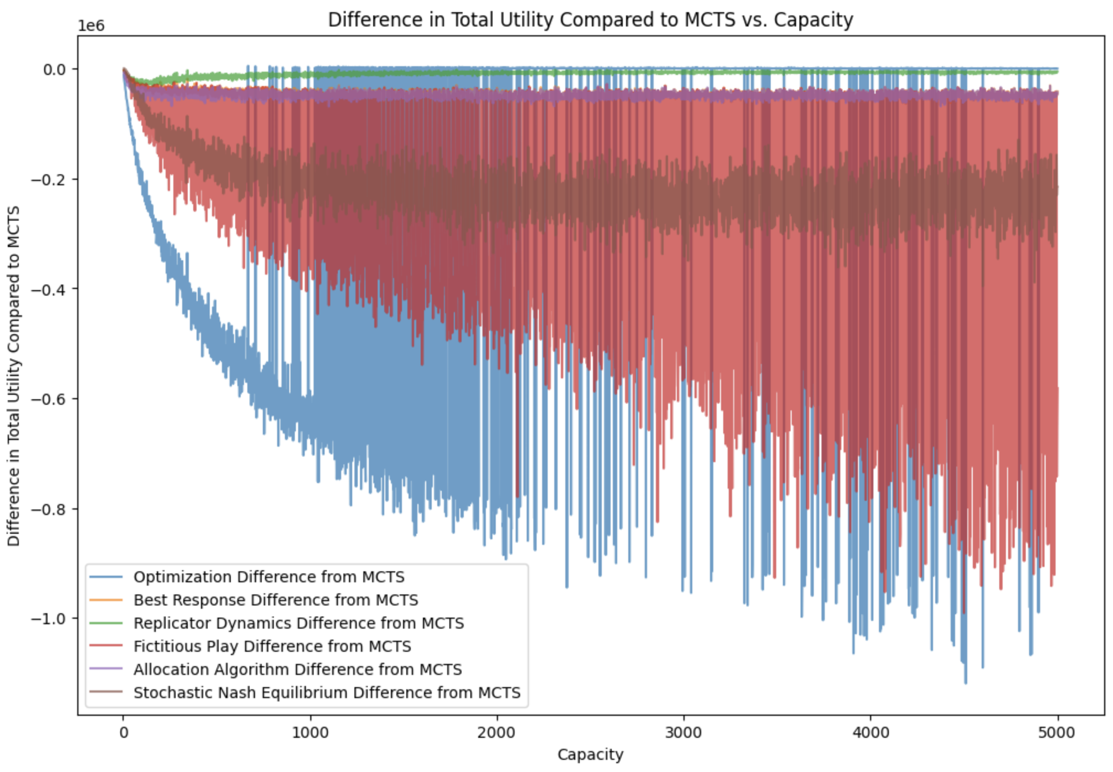

Slide 7
 | Times Better than MCTS
Optimization | 2985
Best Response | 0
Replicator Dynamics | 0
Fictitious Play | 0
Allocation Algorithm | 0
Stochastic Nash Equilibrium | 2

Slide 8
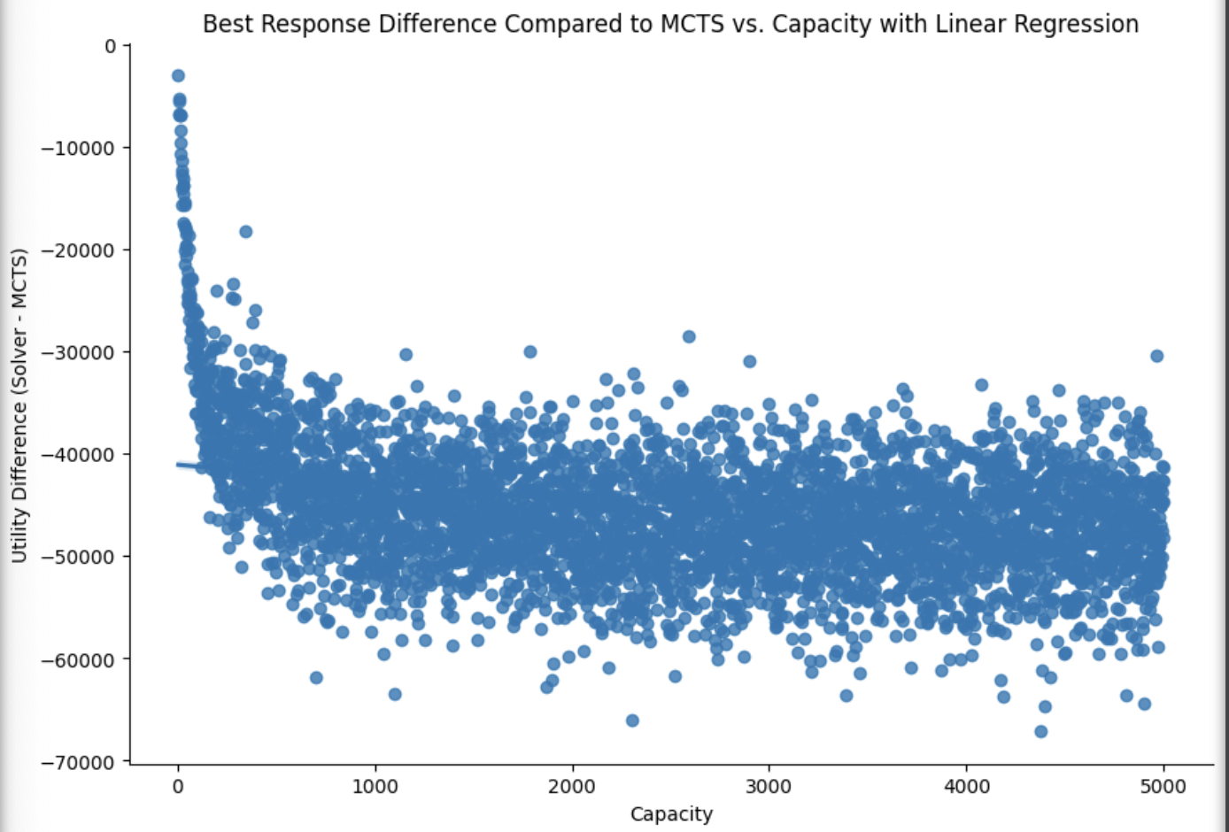

Slide 9
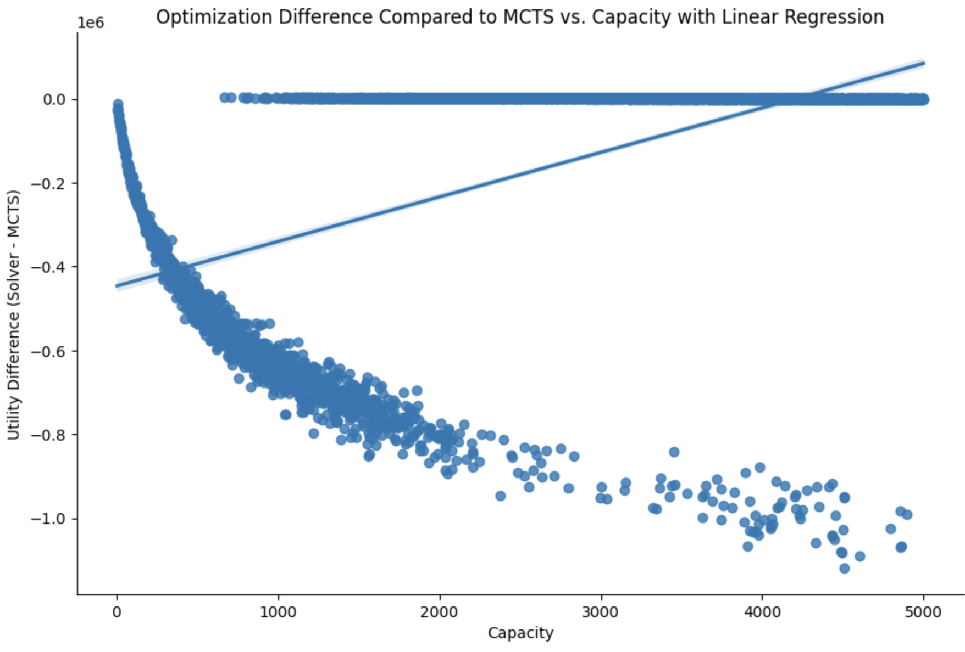

Slide 10
